Slide 1
Outline
Deep Learning
What is a Neural Network?
An example: XOR
Loss and Output Layer
Basic Feedforward Network Architecture
Backpropagation
1 / 33

Slide 2
Outline
Deep Learning 1. What is a Neural Network?
1. What is a Neural Network?
An example: XOR
Loss and Output Layer
Basic Feedforward Network Architecture
Backpropagation
1 / 33

Slide 3
What is a Deep Feedforward Network (DFN)?
Deep Learning 1. What is a Neural Network?
Feedforward networks
(aka feedforward neural networks or multilayer perceptrons)
Given a function y = f∗(x) that maps input x to output y
A DFN defines a parametric mapping ˆy = f(x; θ) with parameters θ
Aim is to learn θ such as f(x; θ) best approximates f∗(x)!
1 / 33

Slide 4
Why Feedforward ?
Deep Learning 1. What is a Neural Network?
Given a Feedforward Network ˆy = f(x; θ)
⁾ Input x, then pass through a chain of steps before outputting y
Example f ¹(x ), f ²(x ) and f ³(x ) can be chained as:
⁾ f (x ) = f ³(f ²(f ¹(x )))
⁾ x is the zero-th layer, or the input layer
⁾ f ¹ is the first layer, or the first hidden layer
⁾ f ² is the second layer, or a second hidden layer
⁾ f ³ is the last layer, or the output layer
No feedback exists between the steps of the chain
⁾ Feedback connections yield the Recurrent Neural Network
Number of hidden layers define the depth of the network
Dimensionality of the hidden layers defines the width of the network

Slide 5
Why Neural ?
Deep Learning 1. What is a Neural Network?
Loosely inspired by neuroscience, hence Artificial Neural Network
Each hidden layer node resembles a neuron
Input to a neuron are the synaptic connections from the previous attached neuron
Output of a neuron is an aggregation of the input vector
Signal propagates forward in a chain of ”Neuron”-to-”Neuron” transmissions
However, modern Deep Learning research is steered mainly by mathematical and engineering principles!

Slide 6
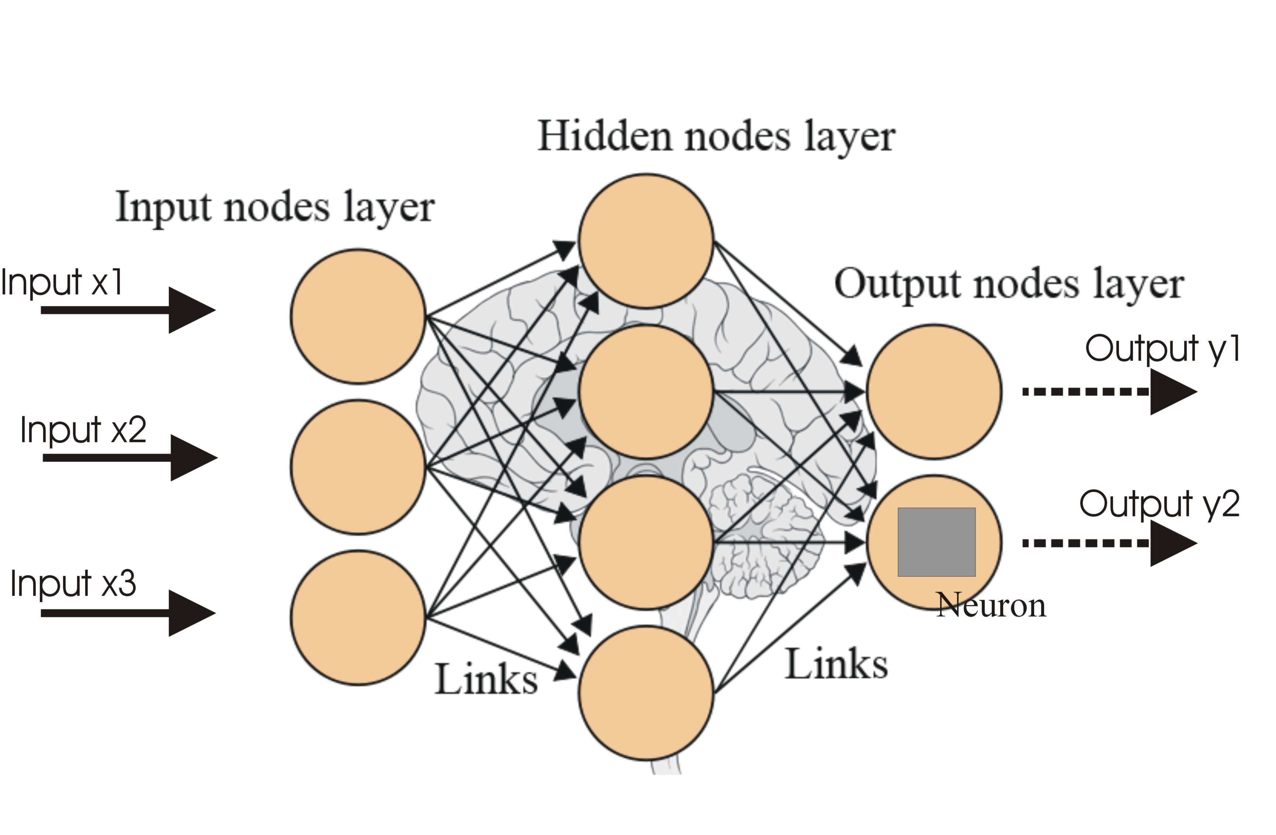
Why Network ?
Deep Learning 1. What is a Neural Network?
A feed-forward network is an acyclic directed graph, but
⁾ Graph nodes are structured in layers
⁾ Directed links between nodes are parameters/weights
⁾ Each node is a computational functions
⁾ No inter-layer and intra-layer connections (but possible)
⁾ Input to the first layer is given (the features x)
⁾ Output is the computation of the last layer (the target ˆy)
Figure 1: FNN, Source www.analyticsvidhya.com

Slide 7
Nonlinear Mapping
Deep Learning 1. What is a Neural Network?
We can easily solve linear regression, but not every problem is linear.
Can the function f (x ) = (x + 1)² be approximated through a linear function?
5 / 33

Slide 8
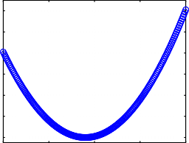
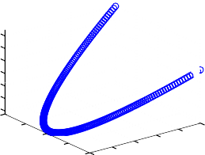
Nonlinear Mapping
Deep Learning 1. What is a Neural Network?
We can easily solve linear regression, but not every problem is linear.
Can the function f (x ) = (x + 1)² be approximated through a linear function?
Yes, but only if we map the feature x into a new space:
f(x)=(x+1)^2
f(a,b)= a + 2 b + 1
120
100
80
120
100
80
60
40
20
0
10
f(a,b)
f(x)
60
40
20
0
-10
5
0
₈₀ 100
b = x
-5
₄₀ 60
-5
0
x
5
10
-10 0
20
a = x^2
Figure 2: Mapping feature x into a new dimensionality x → φ(x ) = (a, b)
5 / 33

Slide 9
Nonlinear Mapping (II)
Deep Learning 1. What is a Neural Network?
Which mapping φ(x ) is the best?
There are various ways of designing φ(x ):
Hand-craft (manually engineer) φ(x)
Use a very generic φ(x), RBF or polynomial expansion
Parametrize and learn the mapping f(x; θ, w) := φ(x; θ)^{T}w
Deep Feedforward Networks follow the third approach, where:
  the hidden layers (weights θ) learn the mapping φ(x ; θ)
  the output layer (weights w ) learns the function g (z ; w ) := z ^{T} w

Slide 10
Nonlinear Mapping
Deep Learning 1. What is a Neural Network?
consider the function
f (x ) = x ² + 2e^{x} + 3x − 5
from which latent features can it be linearly combined:
  x ²
  x ², x, e^{x}
  x, e^{x}
  x ², x, e^{x} , sin(x )

Slide 11
Outline
Deep Learning 2. An example: XOR
1. What is a Neural Network?
2. An example: XOR
Loss and Output Layer
Basic Feedforward Network Architecture
Backpropagation
8 / 33

Slide 12
An example - Learn XOR
Deep Learning 2. An example: XOR
XOR is a function:
x₁ | x₂ | y = f ∗(x )
0 | 0 | 0
0 | 1 | 1
1 | 0 | 1
1 | 1 | 0
Can we learn a DFN ˆy = f(x; θ) such that f resembles f ∗?
Our dataset
0
0
1
0
0
1
1
1
train
D := {(
, 0), (
, 1), (
, 1), (
, 0)}
Leading to the optimization:
1
arg min J(θ) :=
Σ
(y − f (x ; θ))²
θ
4
(x,y )∈D^{train}
8 / 33

Slide 13
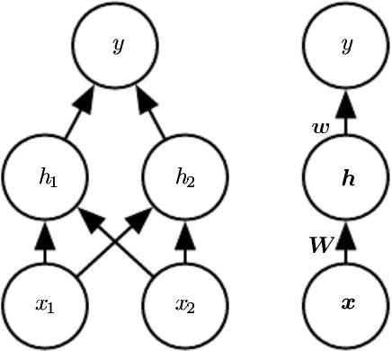
An example - Learn XOR (2)
Deep Learning 2. An example: XOR
We will learn a simple DFN with one hidden layer:
Figure 3: Left: Detailed, Right: Compact, Source: Goodfellow et al., 2016
Two functions are chained h = f ¹(x ; W , c) and y = f ²(h; w, b)
(n)
T (n)
)
For n-th instance: Hidden-layer h = g W x + c
i :,i
i
⁾ For n-th instance: output layer: yˆ_{n} = w ^{T} h^{(n)} + b
⁾ W ∈ R^{2×2}, c ∈ R^{2×1}, w ∈ R^{2×1}, b ∈ R

Slide 14
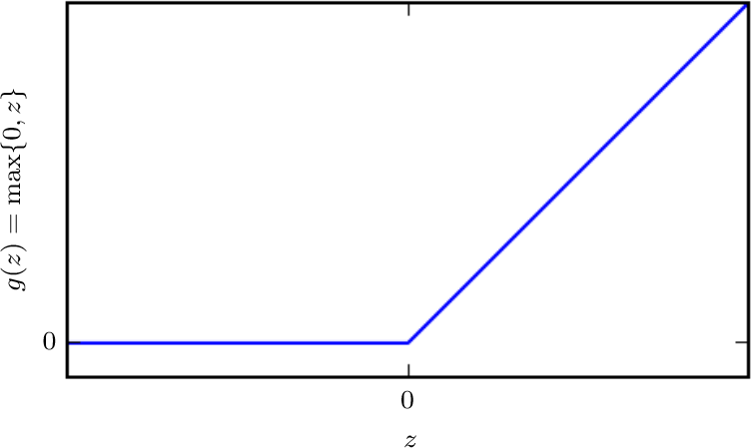
Rectified Linear Unit (ReLU)
Deep Learning 2. An example: XOR
non-linear activation function:
relu(z ) := max{0, z }
node:
f (z ) := relu(Wz ) = max{0, Wz } = (max{0, (W ^{T} z )})_{k=1:K}
k,.
Figure 4: The ReLU activation, Source: Goodfellow et al., 2016

Slide 15
”Deus ex machina” solution?
Deep Learning 2. An example: XOR
Suppose I magically found out that:
1 1 0
1
W =
, c = , w = , b = 0
1 1 −1 −2
We would later on see an optimization technique called backpropagation to learn the network parameters.

Slide 16
XOR Solution - Hidden Layer Computations
Deep Learning 2. An example: XOR
, , , ,
_{h}(1)
T
0
= g W x + c = g 1
1
+ 0 = g (0) = 0
1
:,1 1
0
,
, , ,
_{h}(1)
T
0
= g W x + c = g 1
1
— 1 = g (−1) = 0
2
:,2 1
0
,
, , ,
_{h}(2)
T
0
= g W x + c = g 1
1
+ 0 = g (1) = 1
1
:,1 2
1
,
, , ,
_{h}(2)
T
0
= g W x + c = g 1
1
— 1 = g (0) = 0
2
:,2 2
1
,
, , ,
_{h}(3)
T
1
= g W x + c = g 1
1
+ 0 = g (1) = 1
1
:,1 3
0
,
, , ,
_{h}(3)
1
T
1
— 1 = g (0) = 0
, , ,
= g W x + c = g 1
2
:,2 3
0
,
_{h}(4)
1
T
1
+ 0 = g (2) = 2
, , ,
= g W x + c = g 1
1
:,1 4
1
,
_{h}(4)
T
1
= g W x + c = g 1
1
— 1 = g (1) = 1
2
:,2 4
1

Slide 17
XOR Solution - Output Layer Computations
Deep Learning 2. An example: XOR
, ,
_{yˆ}(1)
0
= w ^{T} h⁽¹⁾ + b = 1 −2
= w ^{T} h⁽²⁾ + b = 1 −2
= w ^{T} h⁽³⁾ + b = 1 −2
= w ^{T} h⁽⁴⁾ + b = 1 −2
0
+ 0 = 0
, ,
_{yˆ}(2)
1
0
+ 0 = 1
, ,
_{yˆ}(3)
1
0
+ 0 = 1
, ,
_{yˆ}(4)
2
1
+ 0 = 0
The computations of the final layer match exactly those of the XOR function.

Slide 18

Outline
Deep Learning 3. Loss and Output Layer
What is a Neural Network?
An example: XOR
3. Loss and Output Layer
Basic Feedforward Network Architecture
Backpropagation
14 / 33

Slide 19
Maximum Likelihood as Objective
Deep Learning 3. Loss and Output Layer
The loss can be expressed in probabilistic terms as
J(θ) = −E_{(x,y )∼pdata} log p_{model}(y | x )
If our model outputs normal uncertainty:
p_{model}(y | x ) = N (y ; f (x ; θ), σ²)
~ J(θ) = ¹ E (y − f (x ; θ))² + const
2
(x,y )∼p_{data}
the model just outputs the mean f (x ; θ), σ² is its error variance.
14 / 33

Slide 20
Output Layer — Gaussian Output Distribution
Deep Learning 3. Loss and Output Layer
Affine transformation without nonlinearity
⁾ Given features h, produces yˆ = w ^{T} h + b
⁾ activation function is the identify a(h) := h
Interpreted as mean of a conditional Gaussian distribution
⁾ p(y | x ) = N (y ; yˆ, σ²), yˆ := f (x ; θ)

Slide 21
Bernoulli Output Distributions
Deep Learning 3. Loss and Output Layer
Binary target variables follow a Bernoulli distribution
P(y = 1) = p, P(y = 0) = 1 − p
Train a DFN such that yˆ = f (x ; θ) ∈ [0, 1]
Naive Option: clip a linear output layer:
⁾ P(y = 1 | x ) = max 0, min 1, w ^{T} h + b}}
What is the problem with the clipped linear output layer?

Slide 22
Bernoulli Output Distributions (2)
Deep Learning 3. Loss and Output Layer
Use a smooth sigmoid output unit:
_{e}z
yˆ = σ (z ) =
e^{z} + 1
z = w ^{T} h + b
The loss for a DFN f (x ; θ) with a sigmoid output is:
N
Σ
J(θ) = −y log(f (x ; θ)) − (1 − y ) log(1 − f (x
, θ))
n n n
n
n=1
Also called cross entropy

Slide 23
Multinoulli Output Distribution
Deep Learning 3. Loss and Output Layer
For multi-category targets yˆ_{c} = P(y = c | x ), c ∈ {1, . . . , C }
last latent layer: unnormalized log probabilities:
z_{c} = log P˜(y = c | x ) := w ^{T} h + b
c
yields probabilities:
_{e}zc
P(y = c | x ) := softmax(z ) :=
Σ
c
e
z
d
d
Minimizing the log-likelihood loss:
N C
Σ Σ
J(θ) = −I(y = c) log P(y = c | x )
n
n=1 c=1
_{Σ} !
N C
Σ Σ
= −
I(y_{n} = c) z_{c} − log
_{e}z_{d}
n=1 c=1
d

Slide 24
Outline
Deep Learning 4. Basic Feedforward Network Architecture
What is a Neural Network?
An example: XOR
Loss and Output Layer
4. Basic Feedforward Network Architecture
5. Backpropagation
19 / 33

Slide 25
Types of Hidden Units
Deep Learning 4. Basic Feedforward Network Architecture
Question: Can we use no activation function,i.e., only purely linear layers h = W ^{T} x + b?
19 / 33

Slide 26
Types of Hidden Units
Deep Learning 4. Basic Feedforward Network Architecture
Question: Can we use no activation function,i.e., only purely linear layers h = W ^{T} x + b?
Remember the most used hidden layer is ReLU:
h = relu(W ^{T} x + b) = max(0, W ^{T} x + b)
Alternatively, the sigmoid function:
h = σ(z )
or, the hyperbolic tangent:
h = tanh(z ) = 2σ(2z ) − 1
19 / 33

Slide 27
Architecture of Hidden Layers
Deep Learning 4. Basic Feedforward Network Architecture
A DFN with L hidden layers:
_{h}(1)
_{h}(2)
=
=
. . .
=
_{g} (1)_{(W} (1)^{T} _{x + b}(1)₎
_{g} (2)_{(W} (2)^{T} _{h}(1) _{+ b}(2)₎
_{h}(L)
_{g} (L)_{(W} (L)^{T} _{h}(L−1) _{+ b}(L)₎
Different layers can have different activation functions.

Slide 28
Outline
Deep Learning 5. Backpropagation
What is a Neural Network?
An example: XOR
Loss and Output Layer
Basic Feedforward Network Architecture
5. Backpropagation
21 / 33

Slide 29




Computational Graphs
Deep Learning 5. Backpropagation
z₂
+
z
dot
z₁
dot
x
w
x
w
b
z = x ^{T} w
z₂ = z₁ + b = x ^{T} w + b
21 / 33

Slide 30


Computational Graphs
Deep Learning 5. Backpropagation
z₆
z₅
+
relu
z
3
relu
z₄
z₂
+
dot
z₃ w₂
b₂
z₂
+
relu
z
1
dot
z₁
x
w
b
dot
x w1 b₁
z₃ = relu(x ^{T} w + b)
z₆ = relu(w ^{T} relu(x ^{T} w₁ + b₁) + b₂)
2
22 / 33

Slide 31
Forward Computation
Deep Learning 5. Backpropagation
computational graph (Z, E ), a DAG.
⁾ Z a set of node IDs.
⁾ E ⊆ Z × Z a set of directed edges.
For every node z ∈ Z :
⁾ T_{z} : domain of the node (e.g., R¹⁷)
and additionally for every non-root node z ∈ Z :
Q
⁾ f_{z} : T_{z}' → T_{z} node operation
z'∈fanin(z )
forward computation:
Given values v_{z} ∈ T_{z} of all the root nodes z ∈ Z , compute a value for every node z ∈ Z via
^{v}z ^{:= f}z ^{((v}z^{′ )}z′∈fanin(z )⁾
` ˛¸ x
=:v
fanin(z )
Note: fanin_{(Z,E )}(z ) := {z′ ∈ Z | (z′, z ) ∈ E } nodes with edges into z .

Slide 32

Forward Computation / Example
Deep Learning 5. Backpropagation
types for each node:
z₃
T_{x} := R², T_{w} := R², T_{b} := R,
T_{z1} = T_{z2} = T_{z3} := R
relu
z₂
+
functions for each non-root node:
f₁(x, w ) := x ^{T} w, f₂(z₁, b) = z₁ + b,
f₃(z₂) := relu(z₂)
z₁
dot
given values for all root nodes:
x
w
b
2 1
x = , w =
, b = 0.5
1 −1
compute values for all non-root nodes:
z₃ = relu(x ^{T} w + b)
z₁ = 1, z₂ = 1.5, z₃ = 1.5

Slide 33
Forward Computation / Algorithm
Deep Learning 5. Backpropagation
1 cg-forward((Z, E, f ), (v_{z} )_{z ∈roots(Z,E )}) :
2 for z ∈ Z \ roots(Z, E ):
3
^{v}z ^{:= f}z ^{((v}z^{' )}z'∈fanin(z )⁾
4 return (v_{z} )_{z ∈Z}
Note: x⁻y denotes the concatenation of two lists.
25 / 33

Slide 34
Forward Computation / Algorithm
Deep Learning 5. Backpropagation
1 cg-forward((Z, E, f ), (v_{z} )_{z ∈roots(Z,E )}) :
2 for z ∈ Z \ roots(Z, E ) in topological order:
3
^{v}z ^{:= f}z ^{((v}z^{' )}z'∈fanin(z )⁾
4 return (v_{z} )_{z ∈Z}
1 topological-order(Z, E ) :
2 x := ()
3 while Z /= ∅:
4 choose z ∈ roots(Z, E ) arbitrarily
5 delete z in graph (Z, E )
6 x := x⁻(z )
7 return x
Note: x⁻y denotes the concatenation of two lists.
25 / 33

Slide 35
Gradients in Computational Graphs (1/2)
Deep Learning 5. Backpropagation
lets assume every operation is differentiable and
we have for every non-root node z its gradients functions ∇ z = :
∂z
z
′
∂z′
Y
^{g}z,z′ :
T_{z˜}′ → T_{z} × T_{z}′, z ^{r} ∈ fanin(z )
z˜′∈fanin(z )
for any node then we can compute its gradient values w.r.t. its inputs:
^{w}z,z^{′ = g}z,z^{′ ((v}z˜^{′ )}z˜′∈fanin(z )⁾

Slide 36
Gradient Computation / Example
Deep Learning 5. Backpropagation
functions for each non-root node:
f₁(x, w ) := x ^{T} w, f₂(z₁, b) = z₁ + b,
z₃
f₃(z₂) := relu(z₂)
relu
gradient functions for each non-root node:
g_{1,x} (x, w ) := w, g_{1,w} (x, w ) := x,
g_{2,z1} (z₁, b) := 1, g_{2,b} (z₁, b) := 1
z₂
+
g_{3,z2} (z₂) := I(z₂ ≥ 0)
z₁
dot
given values for all root nodes:
2
1
x = , w =
, b = 0.5
1 −1
x
w
b
compute gradient values for all neighbors:
∇_{z2} z₃ = 1, ∇_{z1} z₂ = 1, ∇_{b1} z₂ = 1,
z₃ = relu(x ^{T} w + b)
1
2
∇_{x} z₁ =
, ∇_{w} z₁ =
−1
1

Slide 37



Gradients in Computational Graphs (2/2)
Deep Learning 5. Backpropagation
for any subgraph z ^{rr} → z ^{r} , z ^{r} , . . . , z ^{r} → z by chain rule:
1 2 K
z
K
K
Σ
Σ
∂z ∂z
r
∇ z = ∇
r
k
z
′′
′ z ∇ ′′ z =
z_{k}
z k
∂z ^{r} ∂z ^{rr}
_{z} r _{z} r
. . .
_{z} r
k=1
k=1
k
1
2
K
K
Σ
w ′′ = w ′ g ′
′′ (v ′ )
_{z} rr
z,z z,z z ,z fanin(z )
k k
k
k=1
K
Σ Σ
=
^{(w}z,z^{′ )}.,i ^{g}z′ ,z^{′′ (v}fanin(z′ )⁾i,. ^{∈ T}z ^{× T}z′′
k k k
k=1 i ∈dim T_{z}′
k
this way, gradients between any two nodes in a computational graph can be computed automatically.

Slide 38

Gradient Computation / Example
Deep Learning 5. Backpropagation
gradient values for all neighbors:
∇_{z2} z₃ = 1, ∇_{z1} z₂ = 1, ∇_{b1} z₂ = 1,
z₃
1
2
∇_{x} z₁ =
, ∇_{w} z₁ =
relu
−1 1
z₂
+
gradient values for all node pairs:
∇_{z1} z₃ = 1, ∇_{b}z₃ = 1,
z₁
dot
A.
2
1
∇ z = , ∇ z =
x 3 w
3
1
−1
x
w
b
B.
1
2
∇ z =
, ∇_{w} z₃ =
x 3
−1
1
z₃ = relu(x ^{T} w + b)
1
2
∇ z =
, ∇ z =
x 2
−1
w 2
1
29 / 33

Slide 39
Gradient Computation / Example
Deep Learning 5. Backpropagation
z₃
gradient values for all neighbors:
relu
∇_{z} z₃ = 1, ∇_{z} z₂ = 1, ∇_{b} z₂ = 1,
z₂
+
2 1
1
1
2
∇ z =
, ∇ z =
x 1
−1
w 1
1
gradient values for all node pairs:
z₁
dot
∇_{z} z₃ = 1, ∇_{b}z₃ = 1,
1
1
2
∇ z =
, ∇ z =
x 3
−1
w 3
1
x
w
b
1
2
∇ z =
, ∇ z =
x 2
−1
w 2
1
z₃ = relu(x ^{T} w + b)
29 / 33

Slide 40
Gradient Computation / Algorithm / Single Leaf
Deep Learning 5. Backpropagation
1 cg-gradient((Z, E, f , g ), (v_{z} )_{z ∈roots(Z,E )}) :
2 v := cg-forward((Z, E, f ), (v_{z} )_{z ∈roots(Z,E )})
3 z := single leaf in (Z, E )
4 w_{z,z} := 1
5 for z ′′ ∈ Z \ {z } in reverse topological order:
6 w_{z,z}'' := 0
7 for z ′ ∈ fanout(z ′′):
8
w_{z}'_{,z}'' := g_{z}'_{,z}'' ((v_{z˜}'' )_{z˜}''_{∈fanin(z}'₎)
w_{z,z}'' := w_{z,z}'' + w_{z,z}' w_{z}'_{,z}''
^{return (w}z,z^{' )}z'∈roots(Z,E )
9
10
compute gradients ∇_{z}′ z for single leaf node z and all root nodes z ^{r}
take the subgraph on ancestors(z ) ∩ descendants(Z_{in}) to compute all gradients ∇_{z}′ z for nodes z ^{r} ∈ Z_{in}.

Slide 41
Gradient Computation
Deep Learning 5. Backpropagation
automatic gradient computation in computational graphs combines
⁾ manually specified gradients of elementary functions,
⁾ the chain rule, and
⁾ a useful arrangement of computations
⁾ forward function computations
⁾ backwards gradient computations
⁾ compute each neighbor gradient once (for multiple leaf nodes)
called backpropagation for feedforward neural networks
⁾ algorithm can be formulated without graph terminology

